Slide 1
PUPPETRY
AS AN ART FORM

Slide 2
WHAT DOES PUPPETRY MEAN?
The art of making puppets and presenting puppet shows.

Slide 3
WHAT IS A PUPPET?
A figure whose movements are controlled by someone through, strings, rods, or hand movements.
And by human being himself called MUPPHET.

Slide 4
A puppet is an inorganic object or representational figure animated or manipulated by an entertainer, who is called a puppeteer. It is used in puppetry, which is a very ancient form of theatre.
There are many different varieties of puppets, and they are made of a wide range of materials, depending on their form and intended use. They can be extremely complex or very simple in their construction.

Slide 5
It is very ancient, and is believed to have originated 3000 years BC.
Puppetry is used in almost all human societies both as entertainment – in performance – and ceremonially in rituals (religious performances) to educate people and celebrations such as carnivals.

Slide 6
There is slight evidence for puppetry in the Indus Valley Civilization. Archaeologists have unearthed one terracotta doll with a detachable head able of handling by a string dating to 2500 BC.
Another figure is a terracotta monkey which could be handled up and down by a stick.

Slide 7
CONTEMPORARY PUPPETRY
From early in the 19th century, puppetry began to inspire artists from the 'high-art' traditions.
Puppetry developed throughout the twentieth century in a variety of ways. Supported by the parallel development of cinema, television and other filmed media it now reaches a larger audience than ever.

Slide 8
Puppetry is now probably more familiar through television and movies rather than through live performance, but this still flourishes throughout the world.

Slide 9
TYPES OF PUPPETRY
Hand (Glove) Puppet
Rod Puppet
Shadow Puppet
Hand and Rod Puppet
Hand and Glove Puppet
Marionette (String Puppet)

Slide 10
Hand (Glove) Puppet
There are many variations to a hand puppet. If the puppet does not have a movable mouth, three fingers on one hand become the neck and two arms. This type of puppet is often called a glove puppet. If the puppet has a movable mouth, traditionally the thumb serves as the lower jaw; the four fingers form the upper mouth.

Slide 11
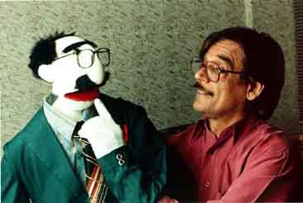

Slide 12
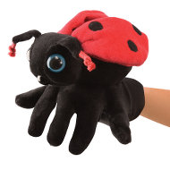

Slide 13
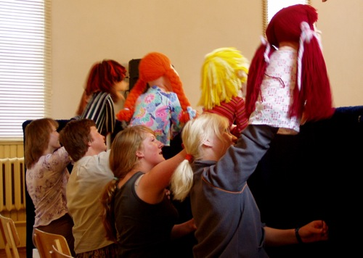

Slide 14
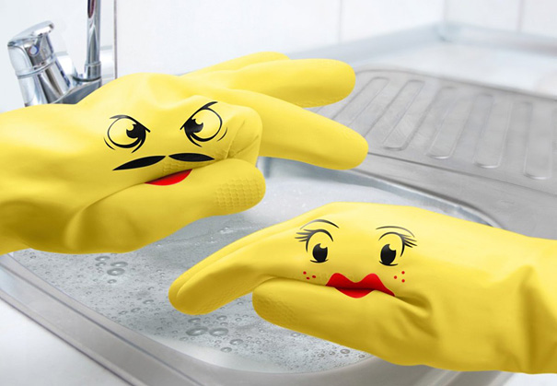

Slide 15
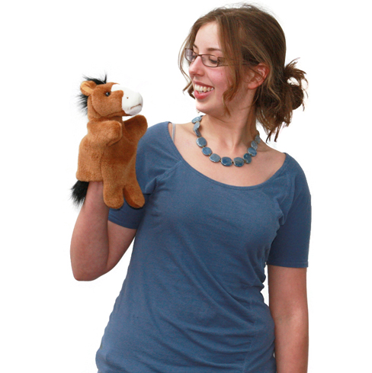

Slide 16
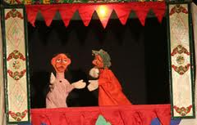

Slide 17
ROD PUPPETS
Sticks or wire rod manipulate rod puppets attached to the neck and hands. In most cases, these controls come from below. Rod puppets may also be worked with rods from above, or any direction necessary for good movement and performance.

Slide 18
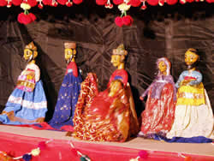

Slide 19
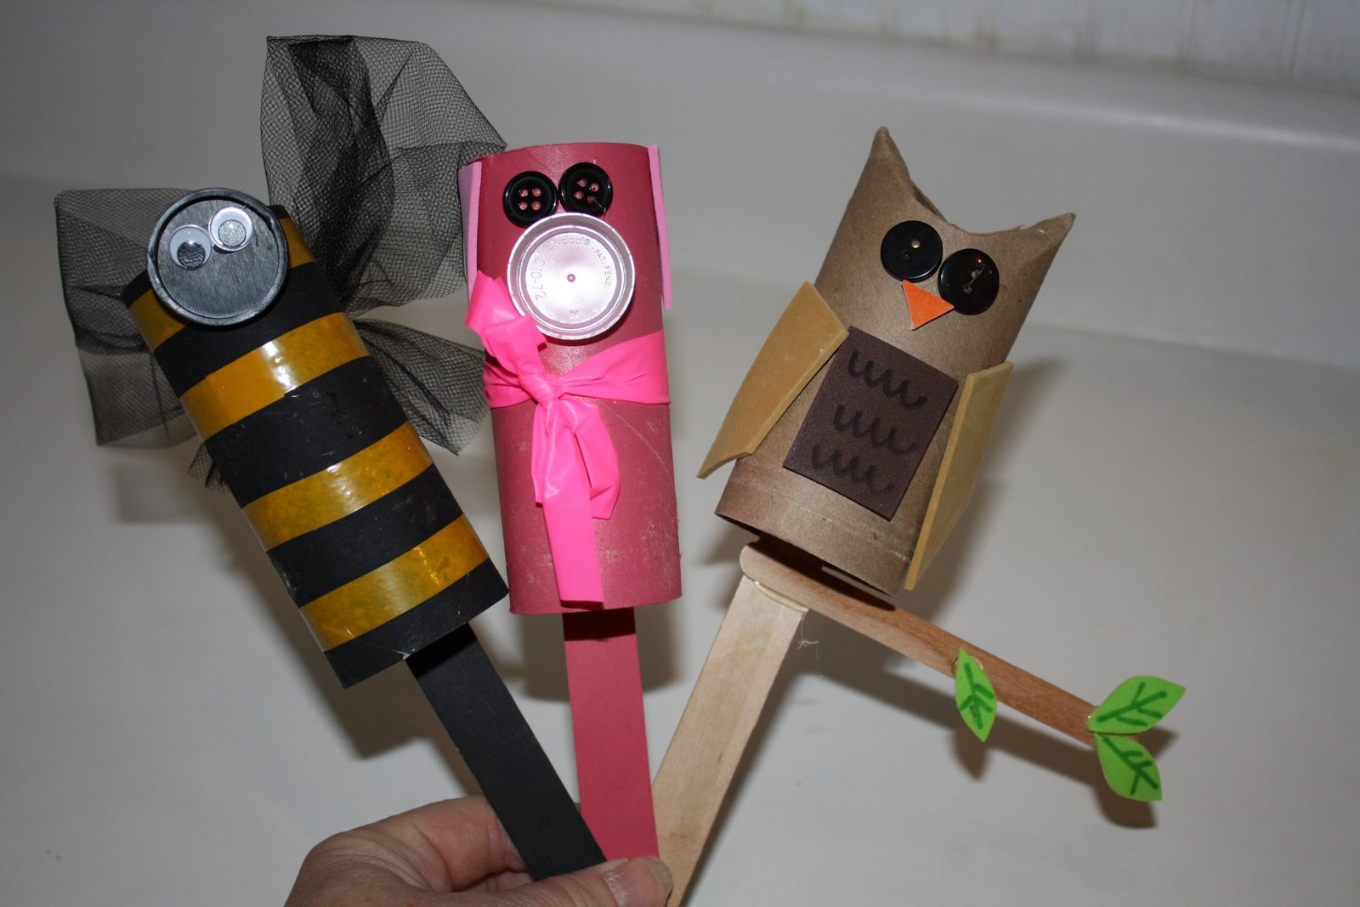

Slide 20
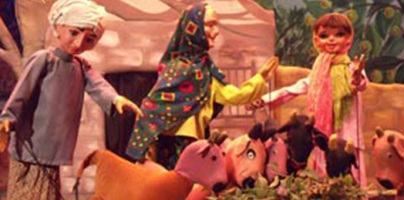

Slide 21
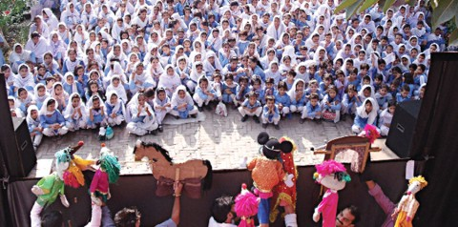

Slide 22
SHADOW PUPPET
Mostly rod puppets, they are made flat and cast a shadow when the puppeteer manipulates them between a light source and a screen (often a piece of muslin stretched like a canvas).
A shadow puppeteer learns to move the puppet in and out of the light so its shadow grows and shrinks and goes in and out of sharp focus.
Traditionally, these are made from animal hides that are painted and punched with decorative designs. Colored acetates are often used to create colors in the puppet's projected shadow.

Slide 23
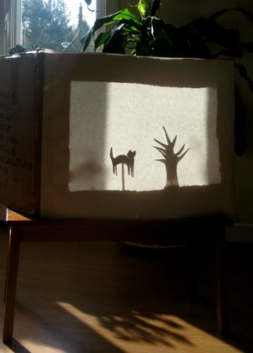

Slide 24
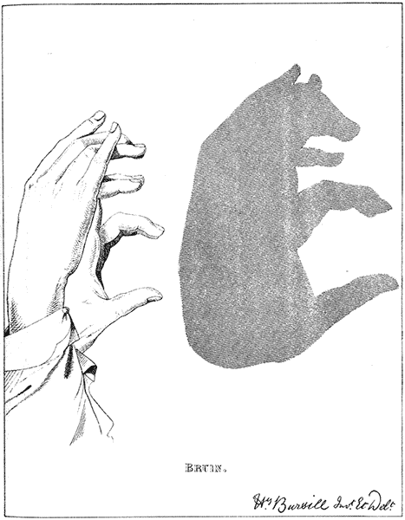

Slide 25
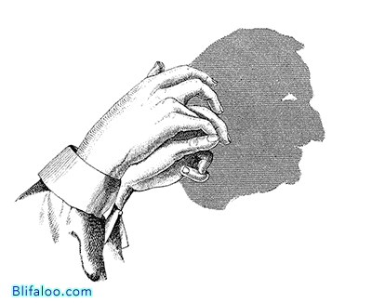

Slide 26
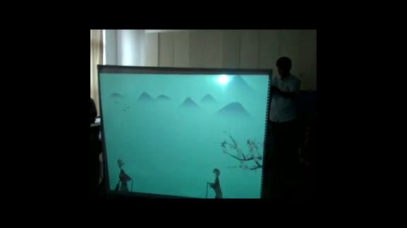

Slide 27
HAND AND ROD PUPPETS
This is the style made famous by the Muppets. The puppeteer uses his hand to move the puppet's mouth while rods attached to the puppet's hands animate the arms.

Slide 28
String Puppets
One of the most difficult forms of puppetry to manipulate effectively, puppets hang on strings. Usually there are eight basic strings to a well-designed puppet. However, some puppets can have thirty or more. A good puppet performer learns how to use gravity to give the puppet life and weight. To work a marionette well, one must practice

Slide 29
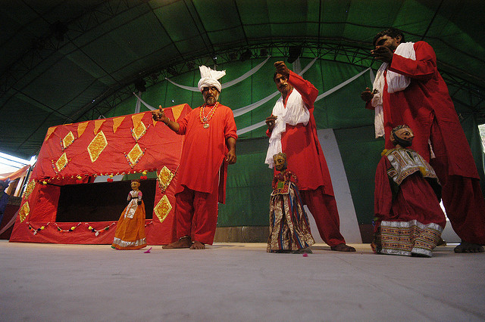

Slide 30
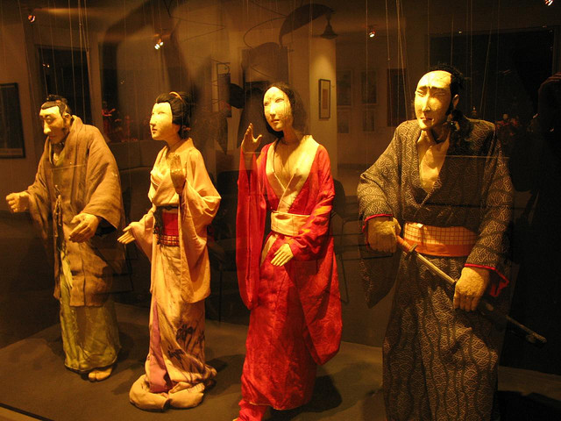

Slide 31
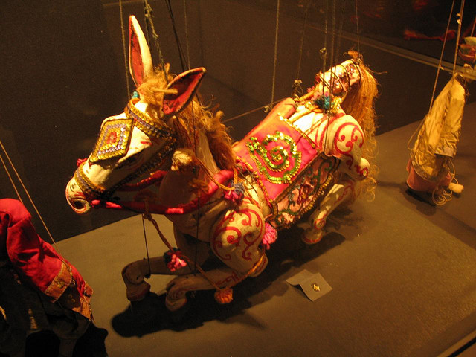

Slide 32
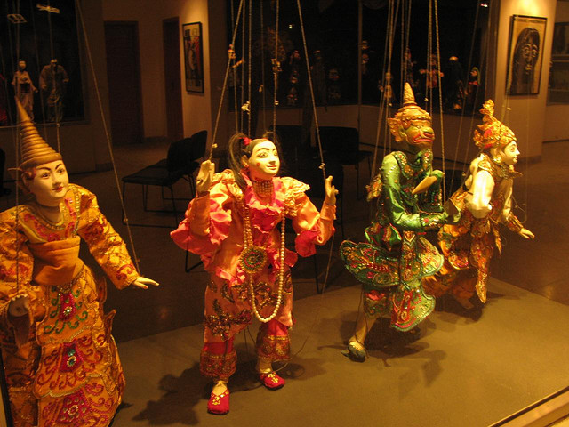

Slide 33
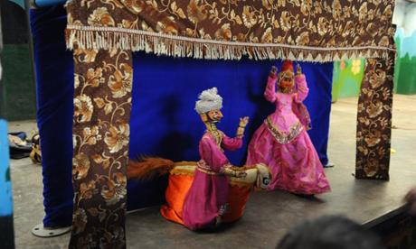

Slide 34
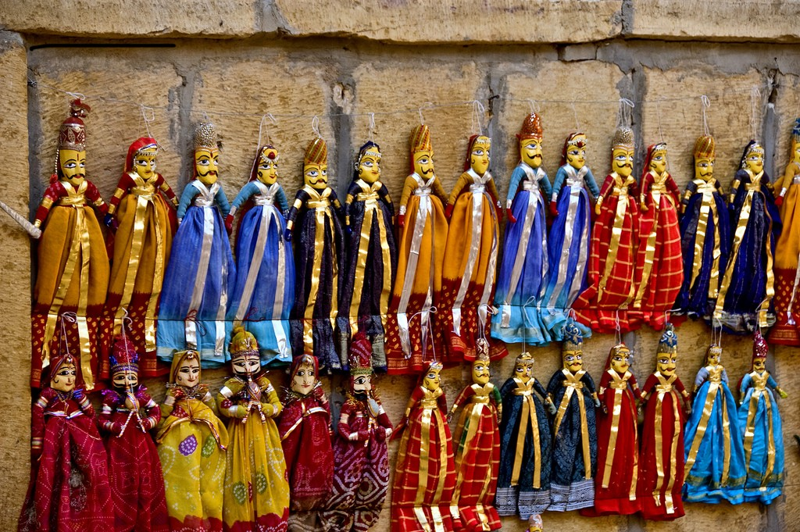

Slide 35
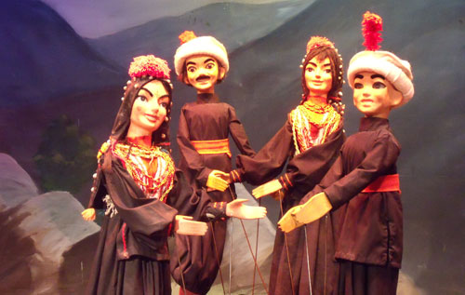

Slide 36
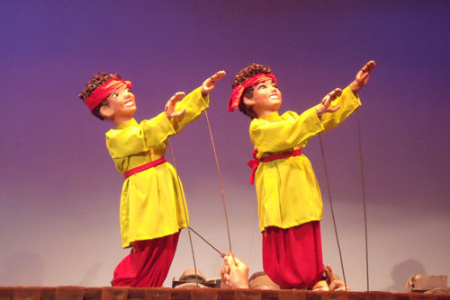

Slide 37
